Slide 1
Predicting Severity of Accidents
Prepared By: Carlos Fortin

Slide 2
Business Problem
The objective of this analysis is to utilize collision data to predict severity of an accident using various features among them weather and road conditions.
Given certain conditions, the model will be able to predict the severity of an accident.

Slide 3
Data
For this analysis, the data being used is from Data-Collisions.csv provided by the course. It can be found here: from https://s3.us.cloud-object-storage.appdomain.cloud/cf-courses-data/CognitiveClass/DP0701EN/version-2/Data-Collisions.csv
There were several features that were dropped due to redundancy or because they were irrelevant to the analysis.

Slide 4
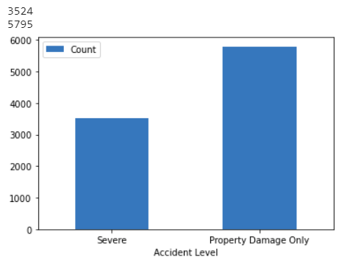
Data
The following chart summarizes severe vs not severe data after cleaning

Slide 5
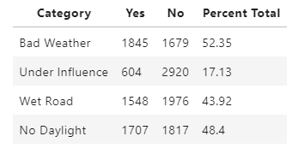
Severe Accidents – summary of severe accident conditions

Slide 6
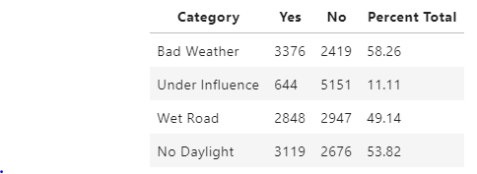
Non-Severe Accidents – summary of non-severe accident conditions

Slide 7
methodology
For this report and analysis, we will attempt to predict whether an accident will be severe or not under the following conditions: Weather, driving under the influence, wet road condition and lack of daylight.
The first step was collecting the data which can be found on the data section of this report. The data initially contained +190,000 rows and 38 features. The second step, was cleaning the data and visualizing it to have a better understanding of what can be used and what should be discarded for this analysis.

Slide 8
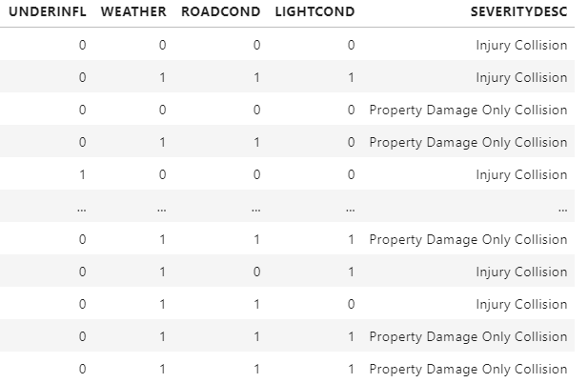
Analysis
After more analysis and data manipulation for usability, the following matrix was developed. It shows all relevant features and the desired variable.

Slide 9
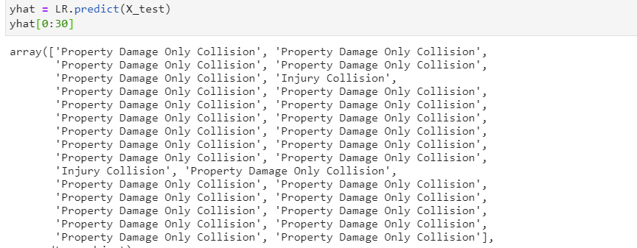
analysis
After developing the Logistic Regression model to predict the severity of an accident, the following matrix is a sample output:

Slide 10
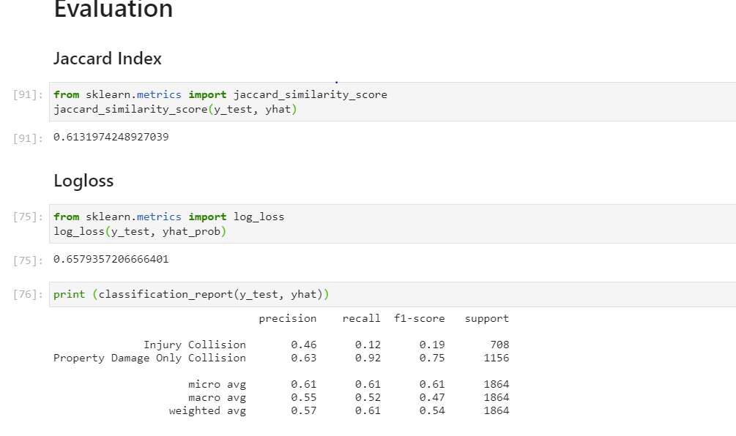
evaluation
To validate the model, the following standard metrics were made:

Slide 11
Discussion & Conclusion
As the data, analysis and evaluation show, Logistic regression is good at predicting the severity of an accident when given the correct features. Since the variable of interest is categorical, logistic regression is also a good model for this prediction.
From general data observation and further analysis, I can note that most accidents occur during poor weather conditions and poor light conditions. In fact, these two factors are the highest determinants of causing an accident.
In conclusion, there are several factors involved in an accident. Some of these factors are impossible to take into considerations so it is important to remember that the even the best prediction model cannot guarantee 100% accuracy. That being said, however, based on my results the two factors that contribute most to an accident happening are weather condition and light condition. In fact, these two factors also contribute to the severity of the accidents as well.
As a recommendation to all people who drive, I would suggest to reconsider travelling when the weather and light conditions are not optimal. If that is not possible, I would encourage extra caution to avoid any collision.

